Slide 1

Supply Chain Management Analysis Story

Slide 2







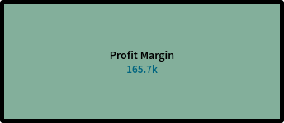
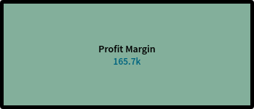


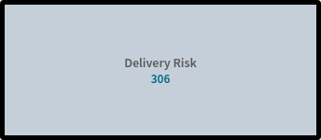
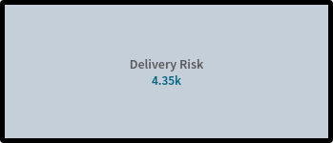


No of sales done in South Asia
No of sales done in
Asian Country
No of Profit margin taken in
South Asia
No of Profit margin taken
in Asian Country
No of Delivery Risk
taken in Asian Country
No of Delivery Risk
taken in South Asia

Slide 3
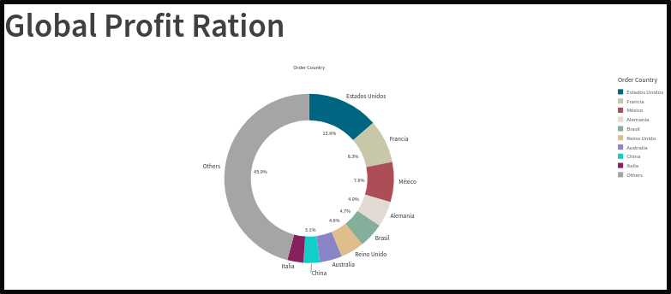

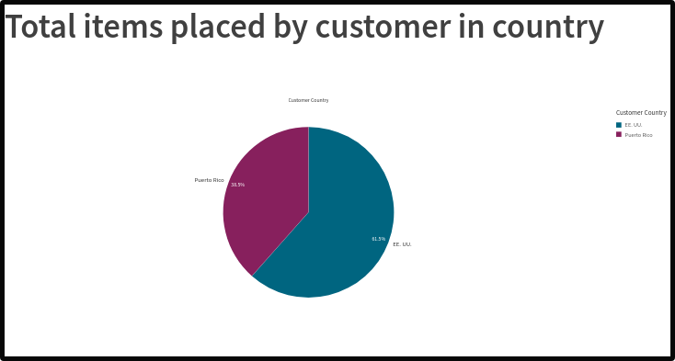

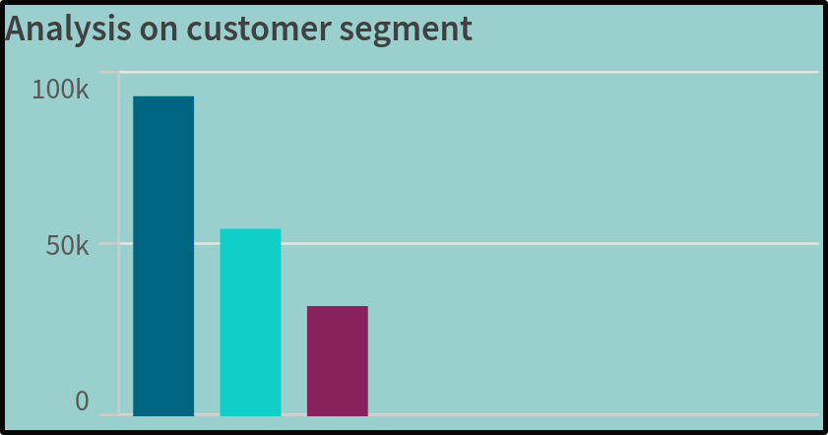
Top 10 Countries In Highest Profit Ratios InSupply Chain Management
Total Items Placed By Customer In Country
Analyzing customer segments, encompassing consumer, corporate, and home categories

Slide 4
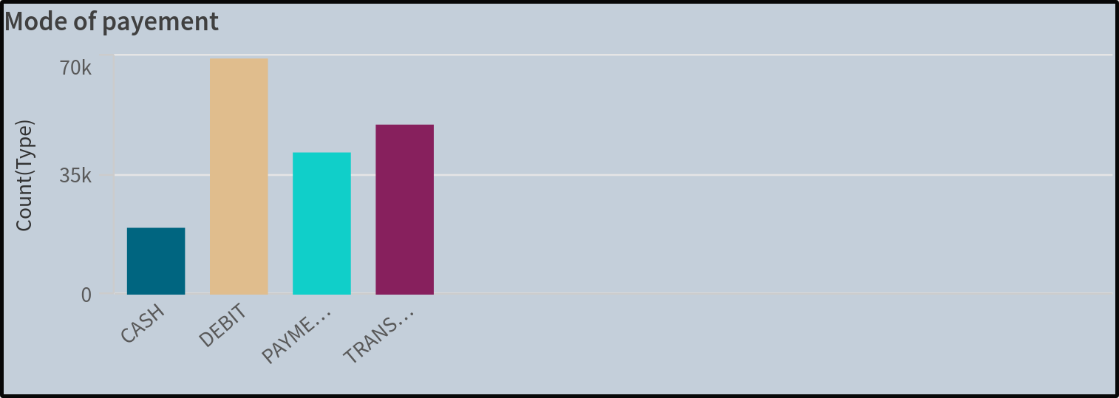
Mode of Payment for Purchase
Cash transactions offer immediate liquidity, providing a straightforward and tangible method of payment.
Debit payments, directly linked to bank accounts, offer convenience and real-time deduction of funds
Credit payments provide a deferred payment option, allowing customers to make purchases
Transfer payments leverage electronic methods for seamless and secure fund

Slide 5
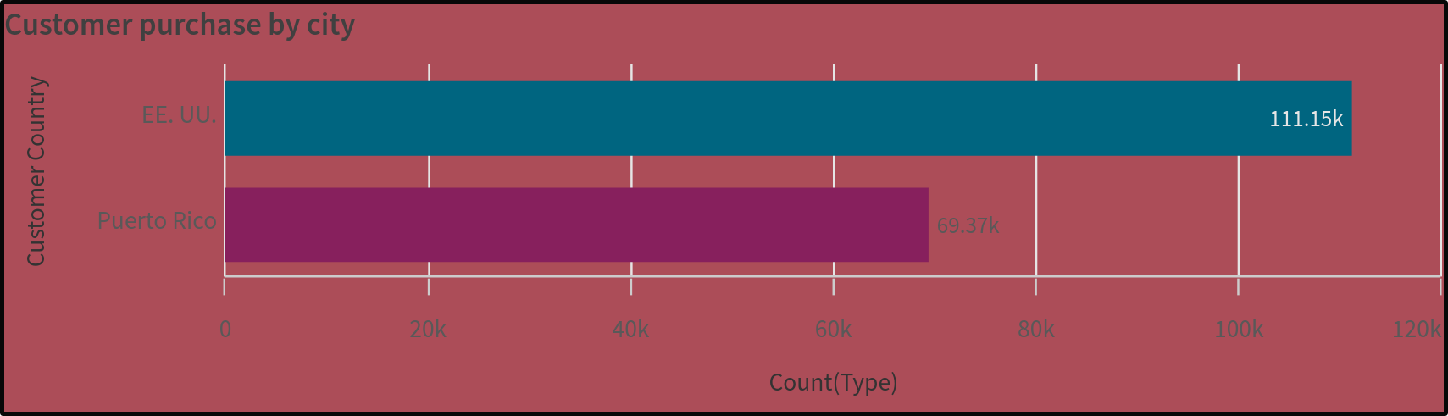
Customer purchase item by city
Customer purchase count in Puerto Rico reflects the transactional dynamics in this vibrant
location, capturing the local consumer behavior and market engagement.
2)Customer purchase count in the United States provides a comprehensive overview of buying patterns across diverse cities.

Slide 6
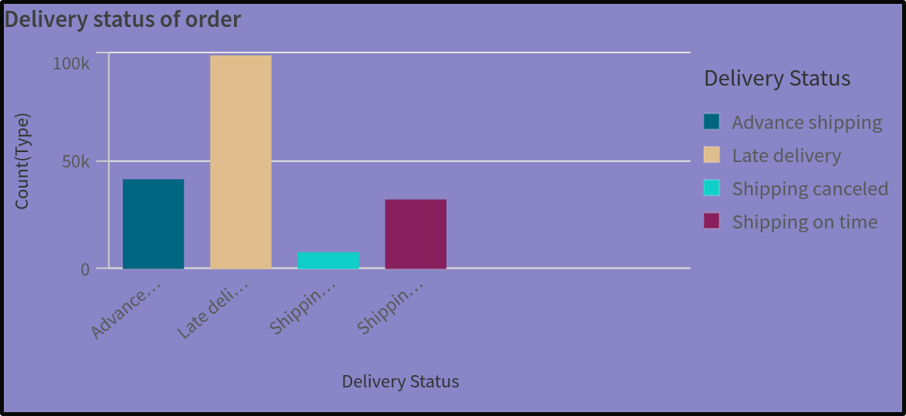
Delivery status of order
Advanced Shipping : This status indicates that the seller has expedited the shipping process or used a
premium shipping service to ensure your order reaches you sooner than the
standard delivery time.
Late Delivery : If your order hasn't arrived by the expected delivery date, it might be labeled as
"late delivery." This could be due to various reasons such as transportation delays,
weather conditions, or logistical issues.
Shipping Canceled : This status means that the shipping process for your order has been terminated
before it was completed. It could be due to several factors such as payment
issues, item unavailability, or customer request.
Shipping On Time : This status signifies that your order is progressing according to the estimated
shipping timeline provided by the seller. It indicates that your order is being
processed, shipped, or delivered within the expected timeframe without any delays.

Slide 7
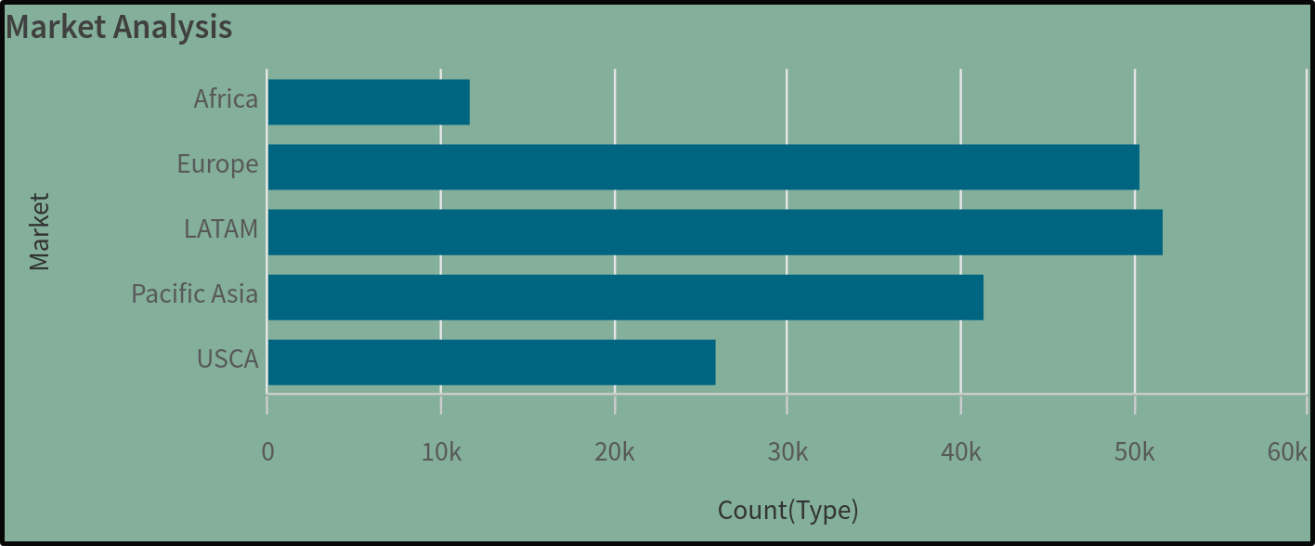
Global Market Analysis
Conducting a market analysis across Africa, Europe, LATAM (Latin America), Pacific Asia,
and USCA (United States and Canada) enables businesses to gain strategic insights.
Regional economic landscapes, consumer behaviors, and market dynamics.
This comprehensive assessment supports informed decision-making, tailored marketing
strategies, and targeted expansion efforts to capitalize on diverse opportunities within
each distinct market.

Slide 8
THANK YOU
Story Presented By
Thota Bhargav
S.R.K.R. Engineering College
Bimavaram

